Slide 1
Welcome to UGRP-6 Kickoff meeting Ved Raval AU2240068

Slide 2
How to read a paper?
First Pass: Category, Context, Correctness, Contributions, Clarity
Second Pass: Graphs, Supporting material, Main Thrust.
Third Pass: Re-implement, Recreate.
StockAssIstant: A Stock AI Assistant for Reliability Modeling of Stock Comments
Zhang, C., Wang, Y., Chen, C., Du, C., Yin, H., & Wang, H. (2018, July). Stockassistant: a stock ai assistant for reliability modeling of stock comments. In Proceedings of the 24th ACM SIGKDD international conference on knowledge discovery & data mining (pp. 2710-2719).

Slide 3
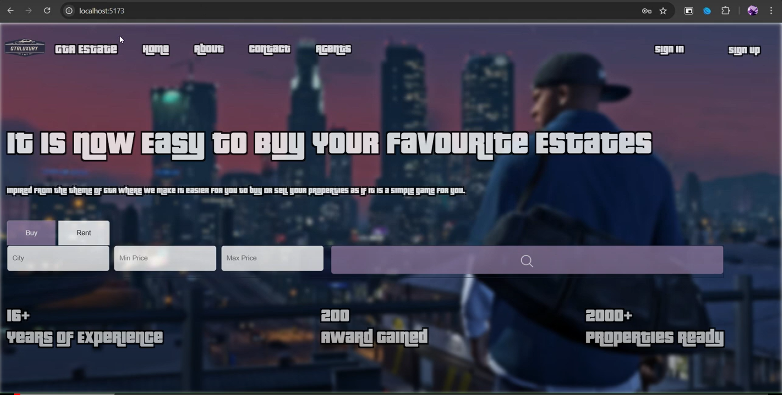
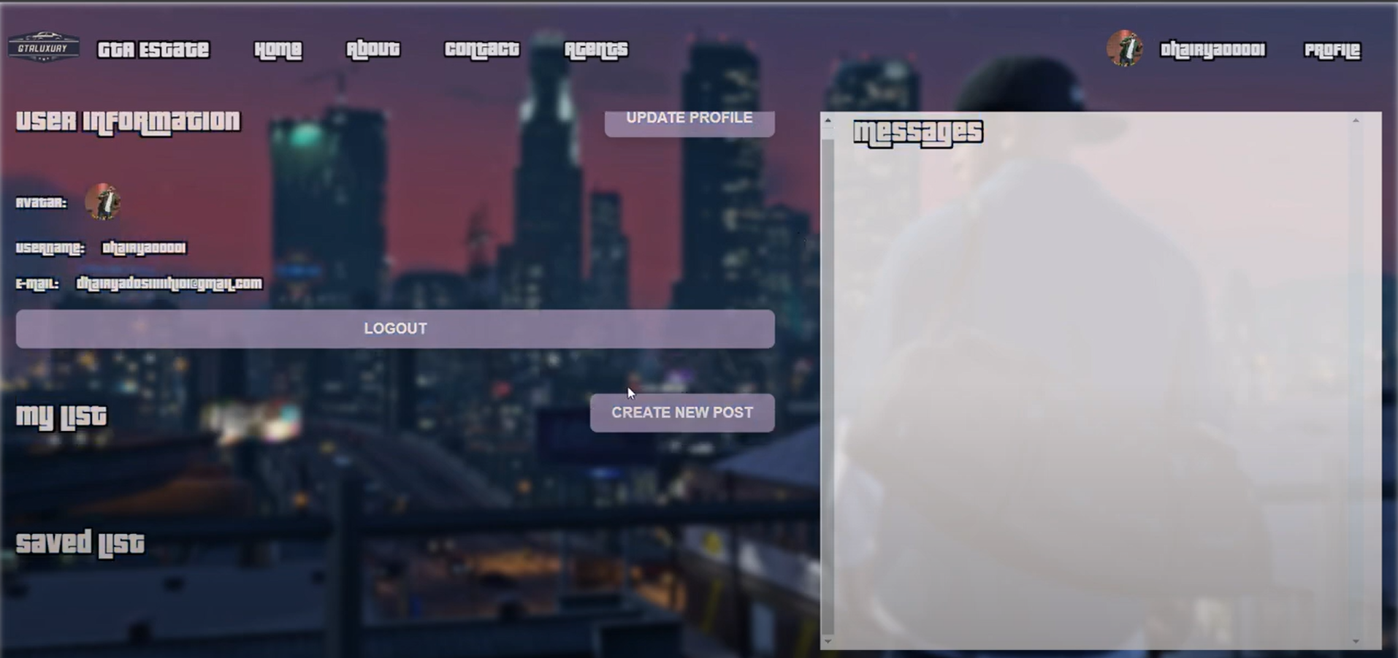
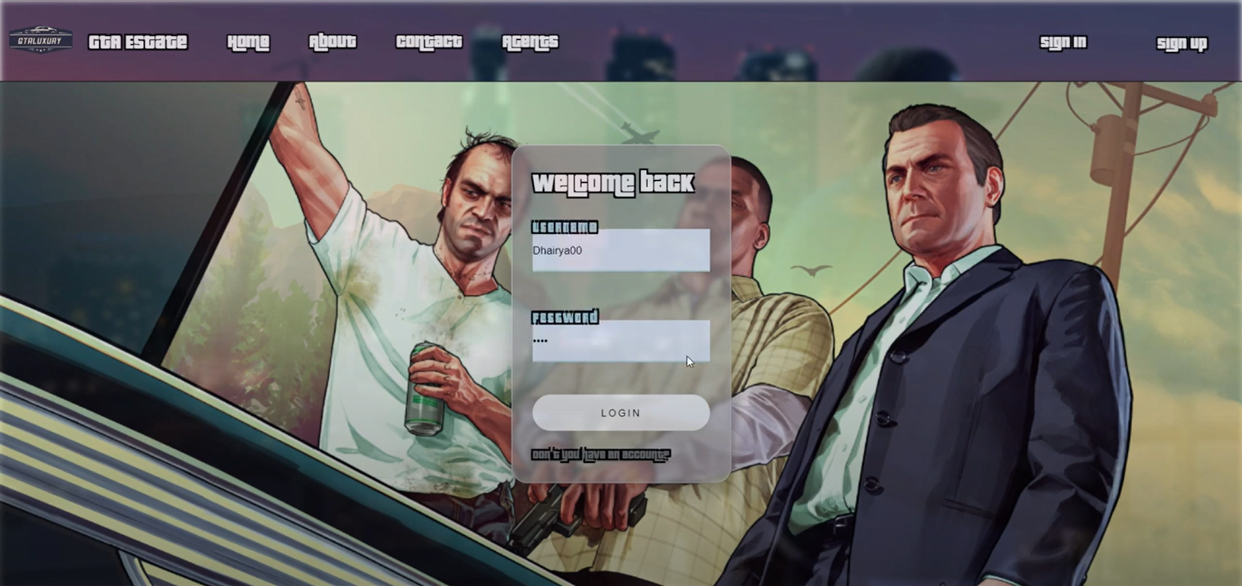
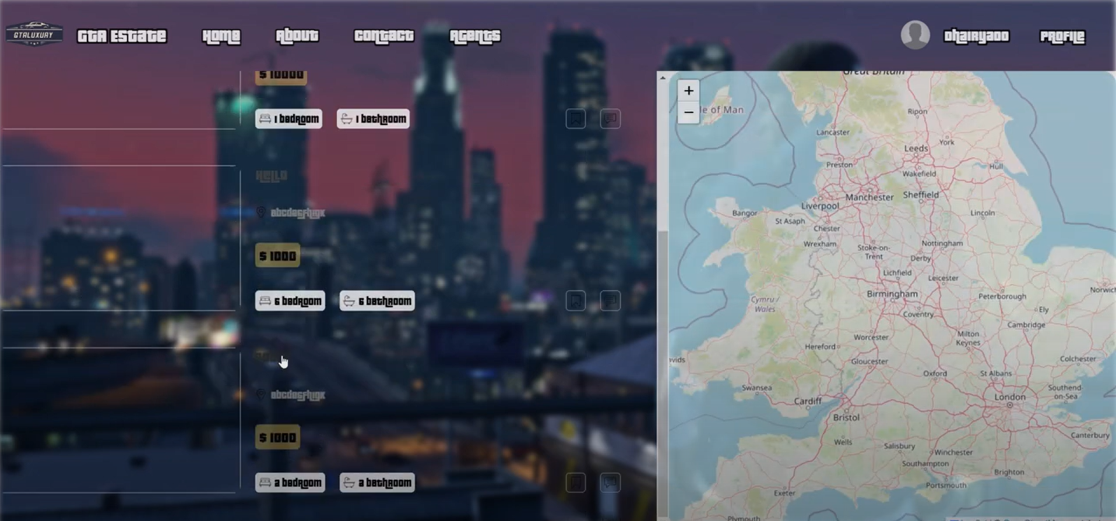
WMC-5.0
Hosting
DBMS (MongoDB)
Prisma ORM
React basics (SCSS)
Postman API
CP contests
Python
Basics of ML

Slide 4
CS50 - Introduction to Computer Science
Scratch and C
Arrays and Algorithms
Python and AI
OOP
Basics of SQL, Memory Management, Cyber Security.
Github

Slide 5
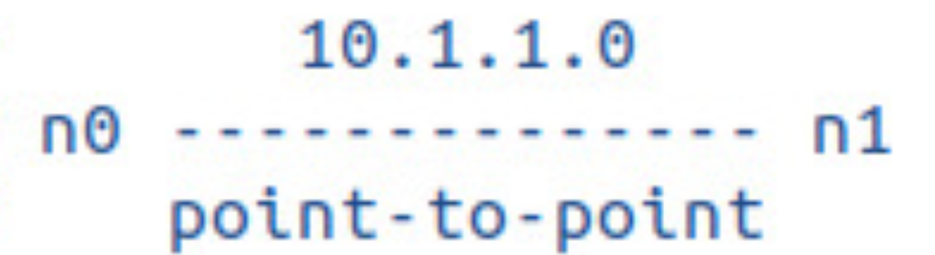
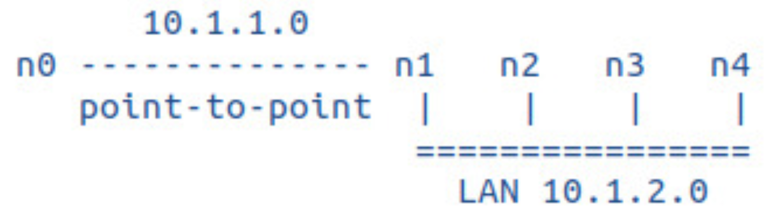
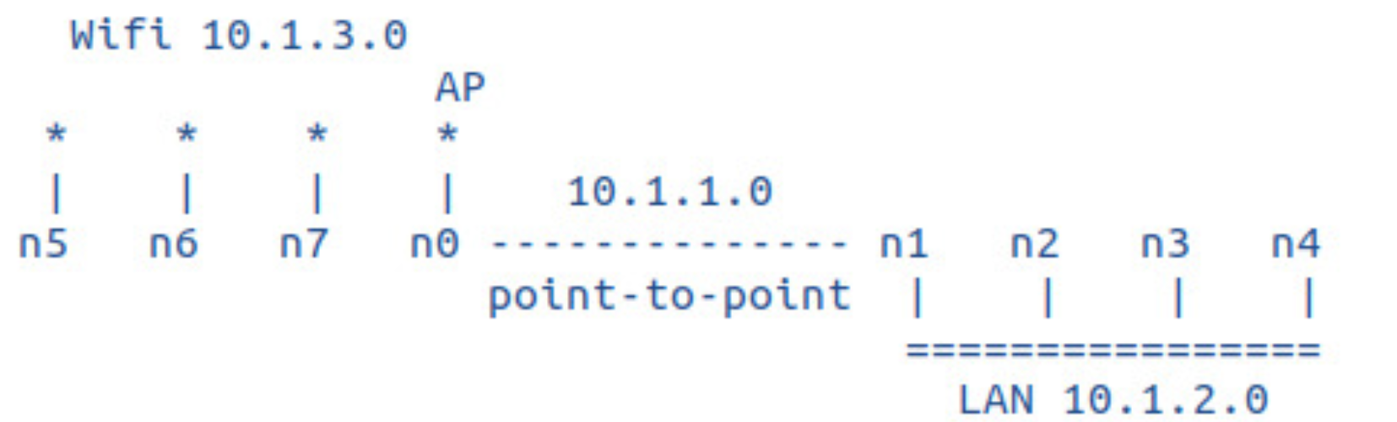
Work in ns-3
Revision of the hands-on session.

Slide 6
Research Domain
Quantitative Finance

Slide 7
Future Plans
GPA
Research in chosen domain (UGRP)
LLMs (GenAI) (In 5th sem)
Summer Internship(After 6th sem)
GRE (Summer vacation)
MS (Abroad)

